Slide 1


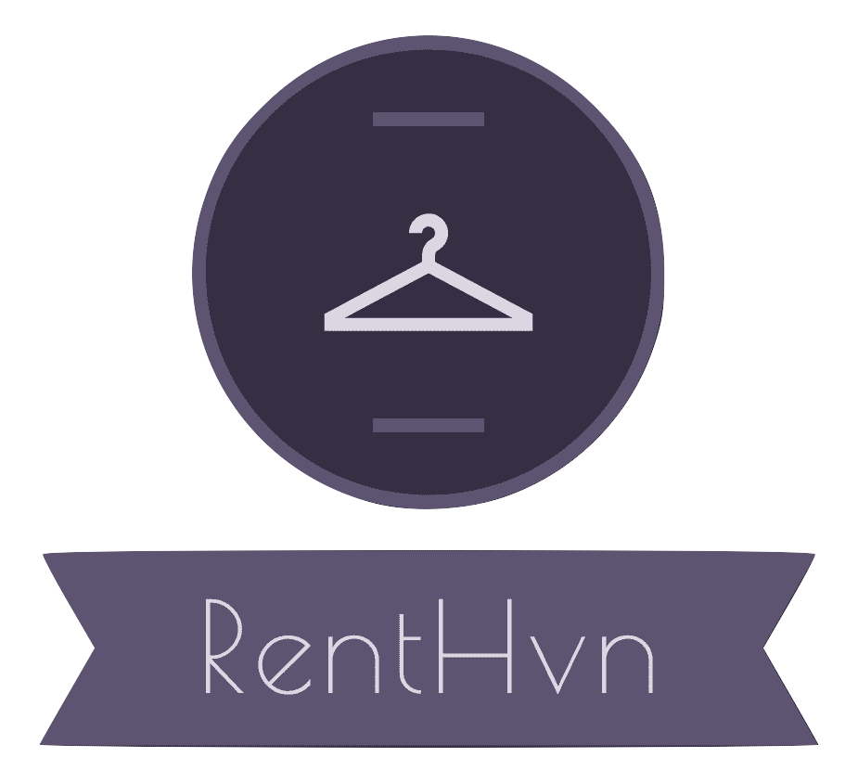


RentHvn
Harpreet Singh Sodhi (B00833691)
Aditya Patel (B00843467)
Tejasvi Vig (B00833705)
Haard Prashant Shah (B00827531)
Shrey Rameshbhai Vaghela (B00834792)

Slide 2
Target Audience and Usage Environment
Target Audience
People looking for a dress to attend a social event
Students getting ready for fresher’s or farewell party
People who have put on weight but are determined to loose it soon and would never want to keep a plus size garment forever
People who not ready to spend much on clothes but always need something new and different in attires to maintain their social status
People who want to donate their old clothes
Place of usage
Can be used wherever there is an internet connection

Slide 3
Problems
Rent:
People restrict themselves from buying clothes because of the budget issues.
Once purchased, the attires are not worn frequently.
Clothes that do not tend to fit with time, go waste.
Donate:
People who want to donate restrict themselves due to lack of knowledge as to whom they are donating and where will their donations go.

Slide 4
Solutions
Rent:
People can save money; they can rent clothes instead of purchasing them.
People will save closet space; rather than having a lot purchases, people can rent.
People can have a lavish lifestyle; especially women who tend to have an exquisite taste and tend to wear clothes from big brands without repeating them.
It saves time for one to go and purchase stuff, people can get their desired dress with a few clicks.
Donate:
People using this application can donate their old clothes without having to worry about the whereabouts of their donation after they donate.

Slide 5


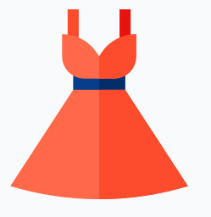


Features
Fast Payment
Secure Login
Easy Clothes Rental Service
Easy Add to Cart
Easy Donations

Slide 6
Motivation
To solve a problem of:
Piles of clothes in a closet
Expensive and fancy enough not to be able to wore on daily basis
Expensive garments fading away before one can use it again
Spending big bucks on a fancy attire just to be wore once

Slide 7
Why not just rent it?
RentHvn will help you:
save space for regular clothes in a closet
wear fancy garments frequently with minimal cost
with saving bucks on expensive and elegant garments

Slide 8
Hey, Philanthropist
RentHvn can also help you:
donate clothes to NGOs
and create extra space for new clothes
help other needy people who could not afford buying new apparels
and feel grateful !!!

Slide 9

Compliance
Usability - RentHvn can be used by users ranging from young to elder as it has minimalist design.
Accessibility - The application can be used by users with an android phone. Things have been taken care so that many people including users with disabilities such as color blindness can access it easily.
Server – User passwords are stored in the server in an encrypted form.

Slide 10
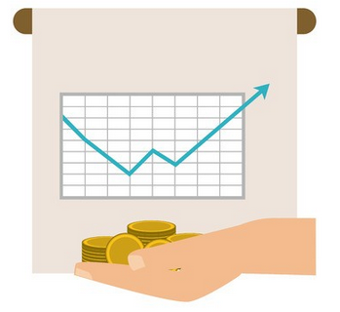
Business Model
How you can get it? – Application is available on GitLab
What is the cost? - Free to use
How it will generate revenue? - The revenue will be generated from customers who will rent our dresses

Slide 11







Activities
Add to Cart
Payment
Rent
Login
User
Home
Sign-up
Take photo
Donate
Ready for Pick-up

Slide 12
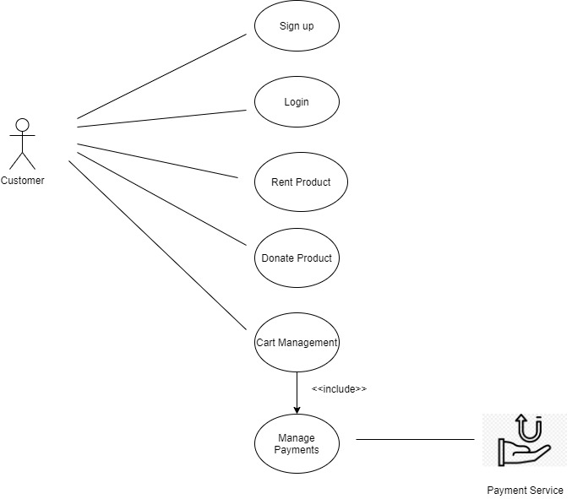
Unified Modelling Language (Use Case Diagram)

Slide 13
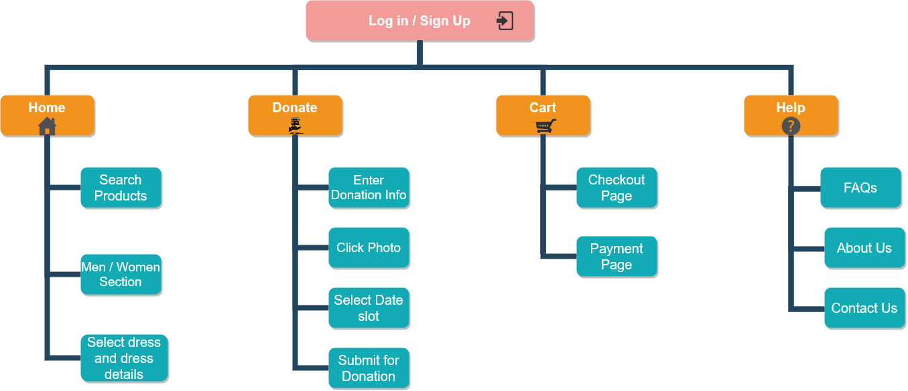
Sitemap

Slide 14
Issues Faced During Development
Kotlin - A big hurdle for us to cross as none of our group members had any prior experience - Kotlin doc references, lab sessions helped us in being efficient in Kotlin.
Firebase - Configuring Firebase in Kotlin along with understanding json response was challenging - Several Firebase documentation and tutorials helped to connect the application with database and host it.
Git - Conflicts while merging the code to the master branch. Git as a source code repository was a new tool for everyone to have worked on - Took us a while to resolve the conflicts.

Slide 15
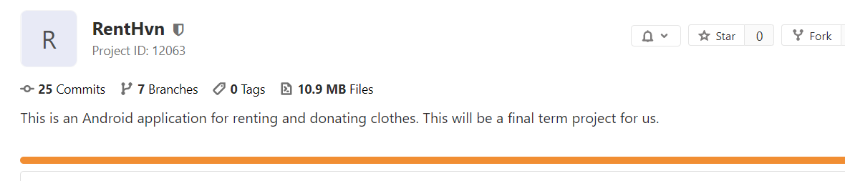
Work Done
Commits: 25 commits
Branches: 7 branches

Slide 16
Quality Assurance(Testing and Review)
Bug Reporting
Bug | Risk | Status | Comments
Navigation Bar/Hamburger on home screen | Minor | Resolved | Navigation Bar/Hamburger was distorting the layout of the home screen
Cart | Minor | Resolved | The page was going to payment despite an empty cart
Payment | Major | Resolved | After payment, user was coming back to the cart page with same cart state
Back Button | Catastrophic | Resolved | The user was coming back to the main screen after logout

Slide 17
Quality Assurance(Testing and Review)
UI Testing
Test Case | Description | Result
Validation Error Messages | We did a thorough check to see if the error messages are displayed to the user are easily read and understandable | All the error messages are easily readable and meaningful
Inconsistencies | We did a thorough check to see if there are inconsistencies in the design and color of all the screens | All the screens were consistent throughout the application
Compatibility | We checked if the application was compatible on different devices by running on emulator and on devices like One Plus 6, Moto 1, etc | Layout doesn’t change across different devices

Slide 18
Quality Assurance(Testing and Review)
Testing
Test Case | Description | Result
Form Validation | We validated the forms on login/sign-up, donation and add to cart page | The validations were successful
Cart Handling | More than 10+ items were being handled by the cart | Heavy load handled properly by the cart
Cart Handling | Scrolling for more than 10+ items were handled | More than 10+ items were easily visible through scrolling

Slide 19
Quality Assurance(Testing and Review)
Testing
Test Case | Description | Result
Session Handling | We checked the session for a user once the application is closed mistakenly by the user and once it is logged out | The cart remains at the same state in first case
Previous Orders | Previous orders were made available to the user after transactions | Previous orders were being able to clearly seen by the user
Cart Value | Cart value for more one item was calculated correctly and accurately | Cart value calculation successful

Slide 20
References
"Flaticon, the largest database of free vector icons", Flaticon, 2020. [Online]. Available: https://www.flaticon.com/ . [Accessed: 02- Apr- 2020].
"The Future Of Compliance: Using Data Better | PYMNTS.com", PYMNTS.com, 2020. [Online]. Available: https://www.pymnts.com/authentication/2019/future-compliance-using-data-better/. [Accessed: 04- Apr- 2020].
"The Science of Why We Buy Clothes We Never Wear", Money, 2020. [Online]. Available: https://money.com/why-we-buy-clothes-we-never-wear/. [Accessed: 02- Apr- 2020].

